Slide 1
UNIT-5
Graphs
Terminology
Representation
Traversals (DFS and BFS).
Heaps
Introduction
Min Heap
Max Heap
Operations on Heaps
Heap Sort
Hashing
Hash Table
Hash functions

Slide 2
Collision resolution techniques
Separate chaining
Open addressing
- Linear probing
- Quadratic probing
- Double hashing

Slide 3
Introduction to Graphs
Definition: A graph G is a pair, G = (V, E), where V is a finite nonempty
set of vertices and E is called the set of edges.
Example:
a
b
c
d
e
V= {a,b,c,d,e}
E=(a,b), (a,c), (a,d), (b,e), (c,d), (c,e), (d,e)}

Slide 4
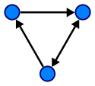

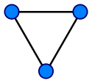

Graph Terminology
A directed graph or digraph is one in which the edges have a direction.
An undirected graph is one in which the edges do not have a direction.

Slide 5
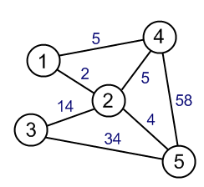
A graph is termed as weighted graph if all the edges in it are labeled with some weights.
The degree of a node is the number of edges it has.
For directed graphs:
  The in-degree of a node is the number of in-edges it has.
  The out-degree of a node is the number of out-edges it has.

Slide 6
The size of a graph is the number of nodes in it
The empty graph has size zero (no nodes).
If two nodes are connected by an edge, they are neighbors (and the nodes are adjacent to each other).
A path is a sequence of nodes such that each node is the predecessor of the next node in the list.
Example: If v₁,v₂,. . .,v_{k} are vertices then v_{i} and v_{i}+1 should be consecutive
Size of graph=3

Slide 7
A simple path is a path in which all the vertices, except possibly the first and last vertices, are distinct.
A cycle in G is a simple path in which the first and last vertices are the same.
A graph without cycles is called acyclic graph.
Sub graph is a graph with subset of vertices and edges of a graph.
A graph is called a simple graph if it has no loops and no parallel edges.
A complete graph is a graph if there is a path from every node to every other node.

Slide 8



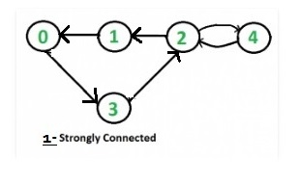
An undirected graph is connected if there is a path from every node to every other node.
A directed graph is strongly connected if there is a path from every node to every other node.

Slide 9
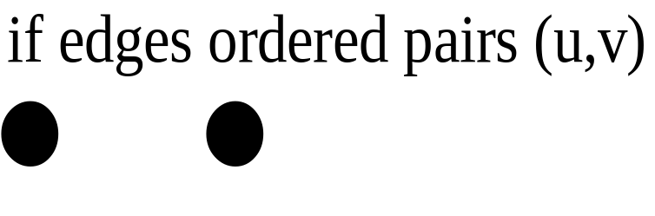
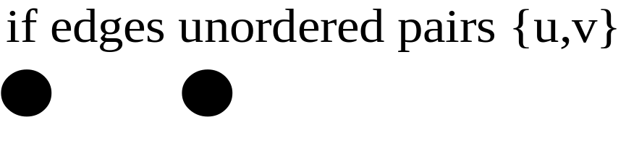
Directed
Un Directed
u
v
u
v
G₂
0
G1
3
in:1, out: 1
0
1
in: 1, out: 2
3
1
2
3
3
3
2
in: 1, out: 0

Slide 10
Cyclic graph
Acyclic graph
Weighted Graph
A
A
A
10
9
B
C
B
C
B
C
6
D
D
Complete Graph
Strongly Connected
A
B
A
D
B
C
D
E
C

Slide 11
0
0
0
1
2
0
1
2
1
2
3
1
2
3
G1
3
(i) ii) (iii) (iv)
(a) Some of the sub graph of G₁
0
0
0
0
1
1
1
2
2
G₂
(i) (ii) (iii)
(b) Some of the sub graph of G₂

Slide 12
Representation of a Graph
There are two ways of representing a graph in memory:
  Sequential Representation by means of Adjacency Matrix.
  Linked Representation by means of Linked List.

Slide 13
Adjacency Matrix is a bit matrix which contains entries of only 0 and 1
The connected edge between two vertices is represented by 1 and absence of edge is represented by 0.
This representation uses a square matrix of order n x n, where n is the number of vertices in the graph.
Adjacency matrix of an undirected graph is symmetric.
Adjacency Matrix
A
A B C D E
A 0 1 1 1 0
B 1 0 1 1 0
C 1 1 0 1 1
D 1 1 1 0 1
E 0 0 1 1 0
B
C
D
E

Slide 14
Linked List Representation
It saves the memory.
The number of lists depends on the number of vertices in the graph.
The header node in each list maintains a list of all adjacent vertices of a
node .
A
B
C
D | NULL
A
B
A
C
D | NULL
A
B
D
E | NULL
B
C
C
D
A
B
C
E | NULL
D
E
N
E
C
D | NULL

Slide 15
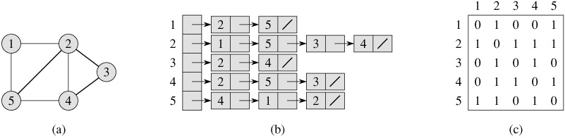
Undirected Graph
Adjacency List
Adjacency Matrix

Slide 16
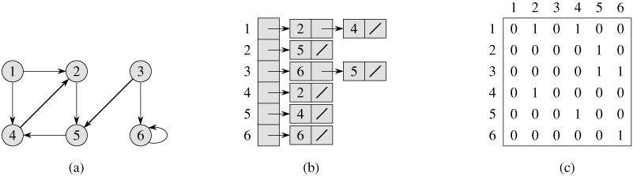
Directed Graph
Adjacency List
Adjacency Matrix

Slide 17
Graph Traversal Techniques
There are two standard graph traversal techniques:
  Depth-First Search (DFS)
  Breadth-First Search (BFS)
Traversing a graph means visiting all the vertices in the graph exactly once.
DFS and BFS traversals result an acyclic graph.
DFS and BFS traversal on the same graph do not give the same order of visit of vertices.

Slide 18
Depth First Traversal:
The depth first traversal is similar to the in-order traversal of a binary tree.
An initial or source vertex is identified to start traversing, then from that vertex
any one vertex which is adjacent to the current vertex is traversed.
To implement the depth first search algorithm, we use a stack.
DFS follows the following rules:
  Select an unvisited node x, visit it, and treat as the current node
  Find an unvisited neighbor of the current node, visit it, and make it the new current node;
  If the current node has no unvisited neighbors, backtrack to the its parent, and make that parent the new current node.
  Repeat steps 3 and 4 until no more nodes can be visited.
  If there are still unvisited nodes, repeat from step 1.

Slide 19
Breadth First Traversal:
The breadth first traversal is similar to the pre-order traversal of a binary tree.
The breadth first traversal of a graph is similar to traversing a binary tree
level by level (the nodes at each level are visited from left to right).
All the nodes at any level, i, are visited before visiting the nodes at level i + 1.
To implement the breadth first search algorithm, we use a queue.
BFS follows the following rules:
  Select an unvisited node x, visit it, have it be the root in a BFS tree being formed. Its level is called the current level.
  From each node x in the current level, visit all the unvisited neighbors of x. The newly visited nodes from this level form a new level that becomes the next current level.
  Repeat step 2 until no more nodes can be visited.
  If there are still unvisited nodes, repeat from Step 1.

Slide 20
Example1:
Graph
A
B
C
D
E
A
B
C
D
A
E
B
C
D
The Depth First Search Tree Order : A, B, E, D, C
E
The Breadth First Search Tree Order : A, B, C, D, E

Slide 21
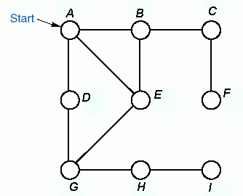

Example2:
A
B
C
A
B
C
D
E
F
D
E
F
G
H
I
G
H
I
DFS Traversal Order
BFS Traversal Order
A B C F E G D H I
A B D E C G F H I

Slide 22
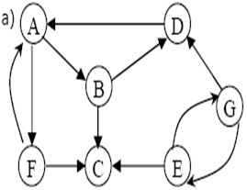
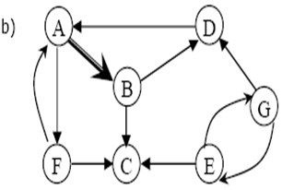
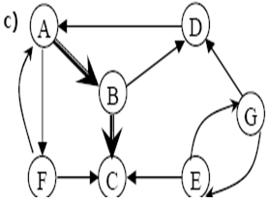
Example3: Construct the DFS and BFS for the following graph.
Depth First Search:
Given Graph
From start vertex A explore edges.
From vertex B either C or D to be explored.

Slide 23
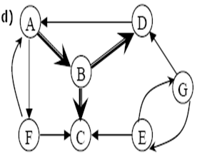
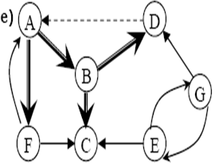
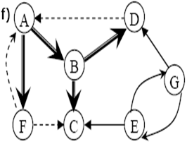
Since C is dead end, backtrack to B, from there explore D.
From D it is possible to explore A, but this would form a cycle, so again backtrack to B, from there backtrack to A, explore the path to F.
The DFS Tree Order : A, B, C, D, F
From F it is possible to traverse either A or c, but both are discovered already. So F is also a dead end.
Note: From the above diagram it is possible to say that G and E are never traversed.

Slide 24
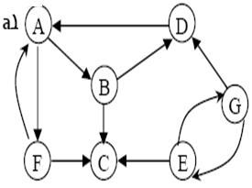
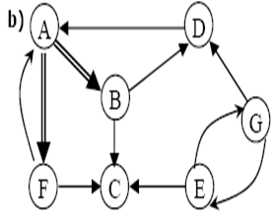
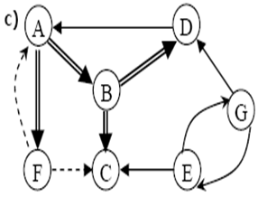
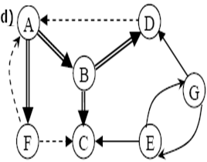
Breadth First Search:
The BFS Tree Order : A,B,F,C,D
Given Graph.
From the start vertex A, the explored
vertices are B and F.
Explore all paths from vertex B and F.
The dashed lines indicate, nodes are
previously discovered.
From D the explored vertex is A.
But A is already visited.
Note: From the above diagram it is possible to say that G and E are never traversed.

Slide 25
Applications of Graphs
Electronic circuits
  Printed circuit board
  Integrated circuit
Transportation networks
  Highway network
  Flight network
Computer networks
  Local area network
  Internet
  Web
Databases
  Entity-relationship diagram

Slide 26
Contents
Heaps: Introduction
Min Heap and Max Heap
Operations on Heaps
Heap Sort.

Slide 27
Representation of a Binary Tree using Array
Sequential Representation :
→ Tree nodes are stored in a linear data structure like array.
→ Root node is stored at index ‘0’
→ If a node is at a location ‘i’,
then its left child is located at 2 * i + 1 and
right child is located at 2 * i + 2
The space required by a binary tree of height h is 2^{h}-1.

Slide 28
Introduction of Heap
Heap is a Completed binary tree data structure
Heap is a implementation of priority queue.
It is a special case of balanced binary tree data structure where the root-node key is compared with its children and arranged accordingly.
If α has child node β then − key(α) ≥ key(β)
As the value of parent is greater than that of child, this property generates Max Heap.

Slide 29
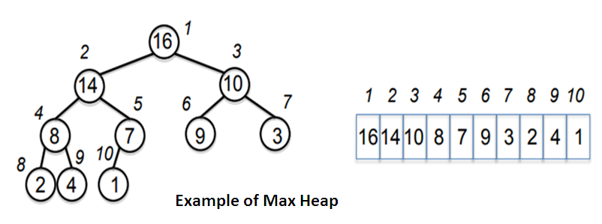

Slide 30
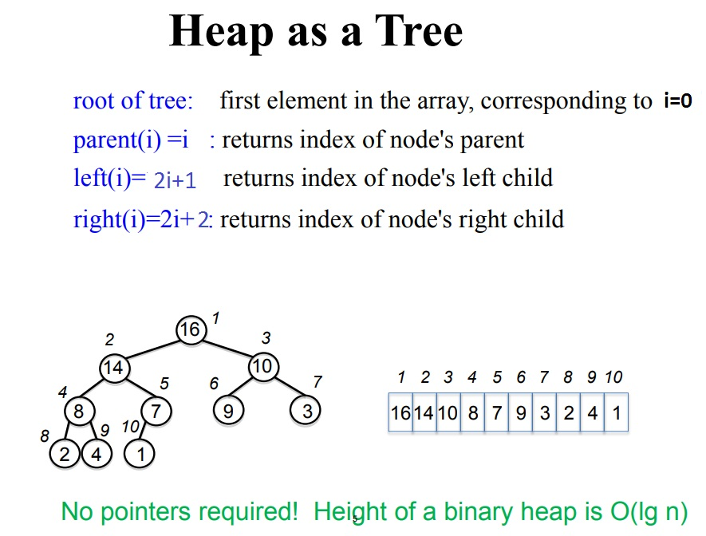

Slide 31

The basic operations we will implement for our binary heap are as follows:
BinaryHeap() : creates a new, empty, binary heap.
insert(k) adds a new item to the heap.
findMax() returns the item with the minimum key value, leaving item in the heap.
delMax() returns the item with the minimum key value, removing the item from the heap.
isEmpty() returns true if the heap is empty, false otherwise.
size() returns the number of items in the heap.
buildHeap(list) builds a new heap from a list of keys.

Slide 32
Heap is two types:
1. Max Heap
2. Min Heap

Slide 33
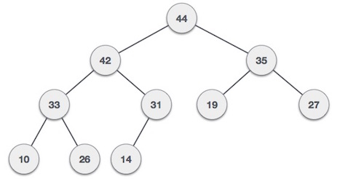
Max-Heap
A max-heap is a binary tree such that
  the data contained in each node is greater than (or equal to) the data in that node’s children.
  the binary tree is complete

Slide 34
Max Heap Insertion Algorithm
Step 1 − Create a new node at the end of heap.
Step 2 − Assign new value to the node.
Step 3 − Compare the value of this child node with its parent.
Step 4 − If value of parent is less than child, then swap them.
Step 5 − Repeat step 3 & 4 until Heap property holds.

Slide 35
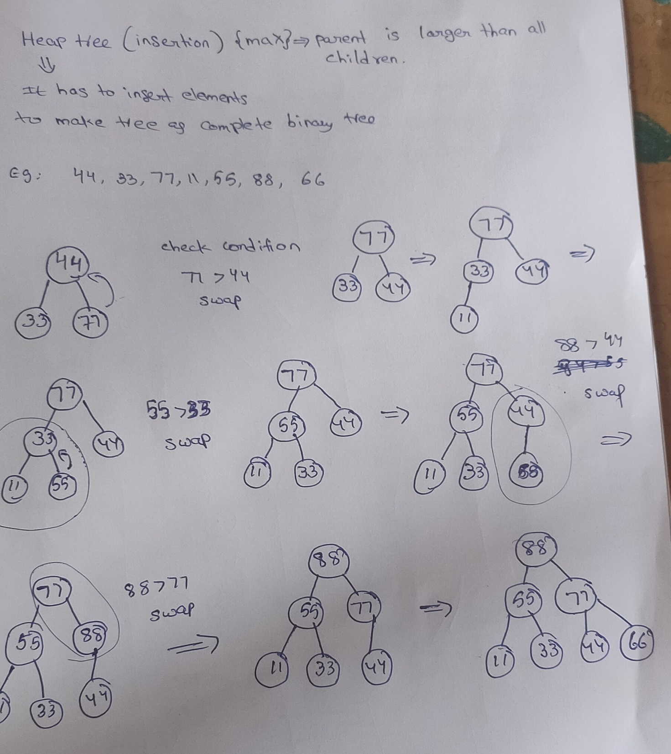

Slide 36
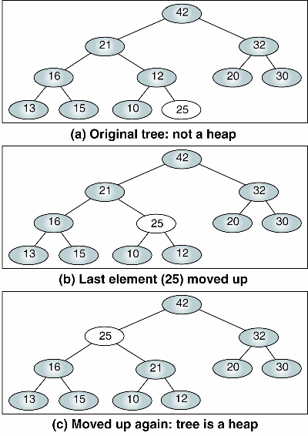
Inserting 25 into Max Heap

Slide 37
Max Heap Deletion Algorithm(or)
Heap Sort Algorithm
Step 1 − Remove root node.
Step 2 − Move the last element of last level to root.
Step 3 − Compare the value of this child node with its parent.
Step 4 − If value of parent is less than child, then swap them.
Step 5 − Repeat step 3 & 4 until Heap property holds.

Slide 38
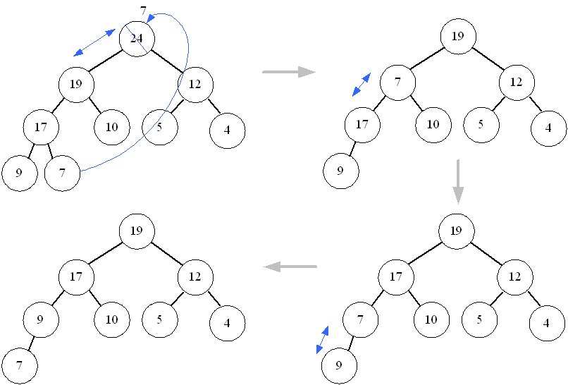
Deleting a node from Max Heap

Slide 39
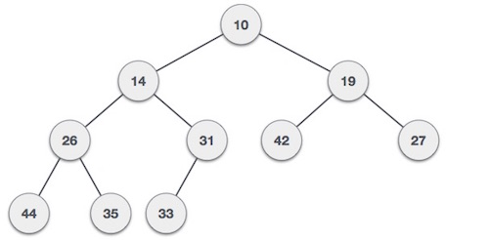
Min-Heap
A min-heap is a binary tree such that
  the data contained in each node is less than (or equal to) the data in that node’s children.
  the binary tree is complete .

Slide 40
Min-Heap Insertion Algorithm
Step 1 − Create a new node at the end of heap.
Step 2 − Assign new value to the node.
Step 3 − Compare the value of this child node with its parent.
Step 4 − If value of parent is greater child, then swap them.
Step 5 − Repeat step 3 & 4 until Heap property holds.

Slide 41
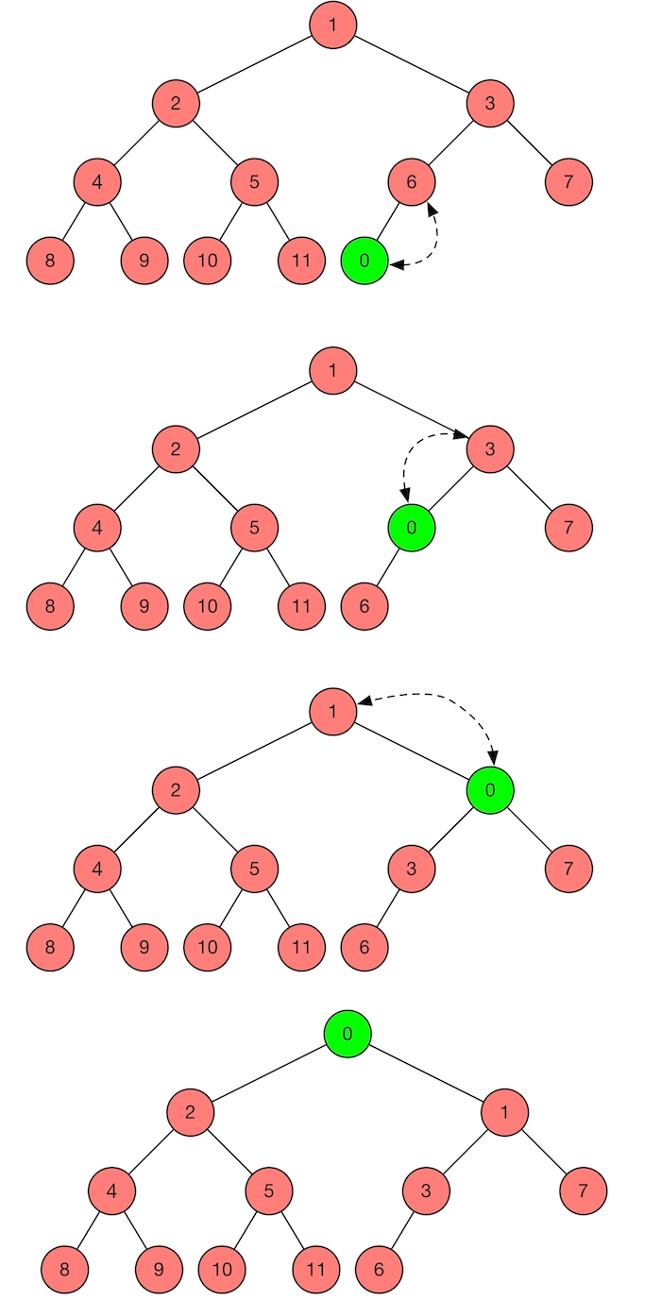
Inserting 0 into Min Heap

Slide 42
Min Heap Deletion Algorithm
Step 1 − Remove root node.
Step 2 − Move the last element of last level to root.
Step 3 − Compare the value of this child node with its parent.
Step 4 − If value of parent is greater than child, then swap them.
Step 5 − Repeat step 3 & 4 until Heap property holds

Slide 43
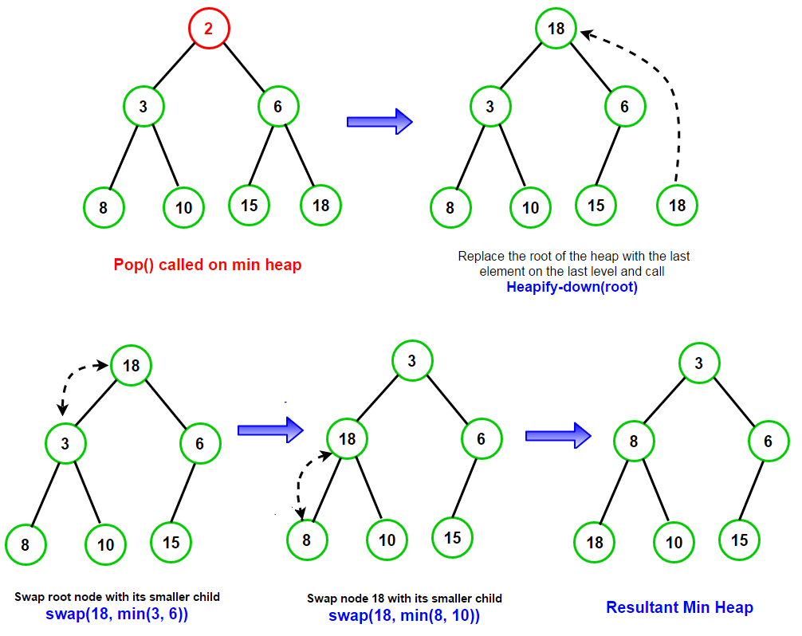
Deleting a node from Min Heap

Slide 44
Heap Sort
Step 1: Build max heap from given input
Step 2: Since the tree satisfies Max Heap property, then the largest is stored at the root node.
Step 3: Remove the root element and put at the end of array, put the last item of tree at vacant place
Step 4: Reduce the size of heap by 1 and heapify the root element again so that we have highest element at root.
Step 5: This process is repeated until all the elements of list are sorted

Slide 45
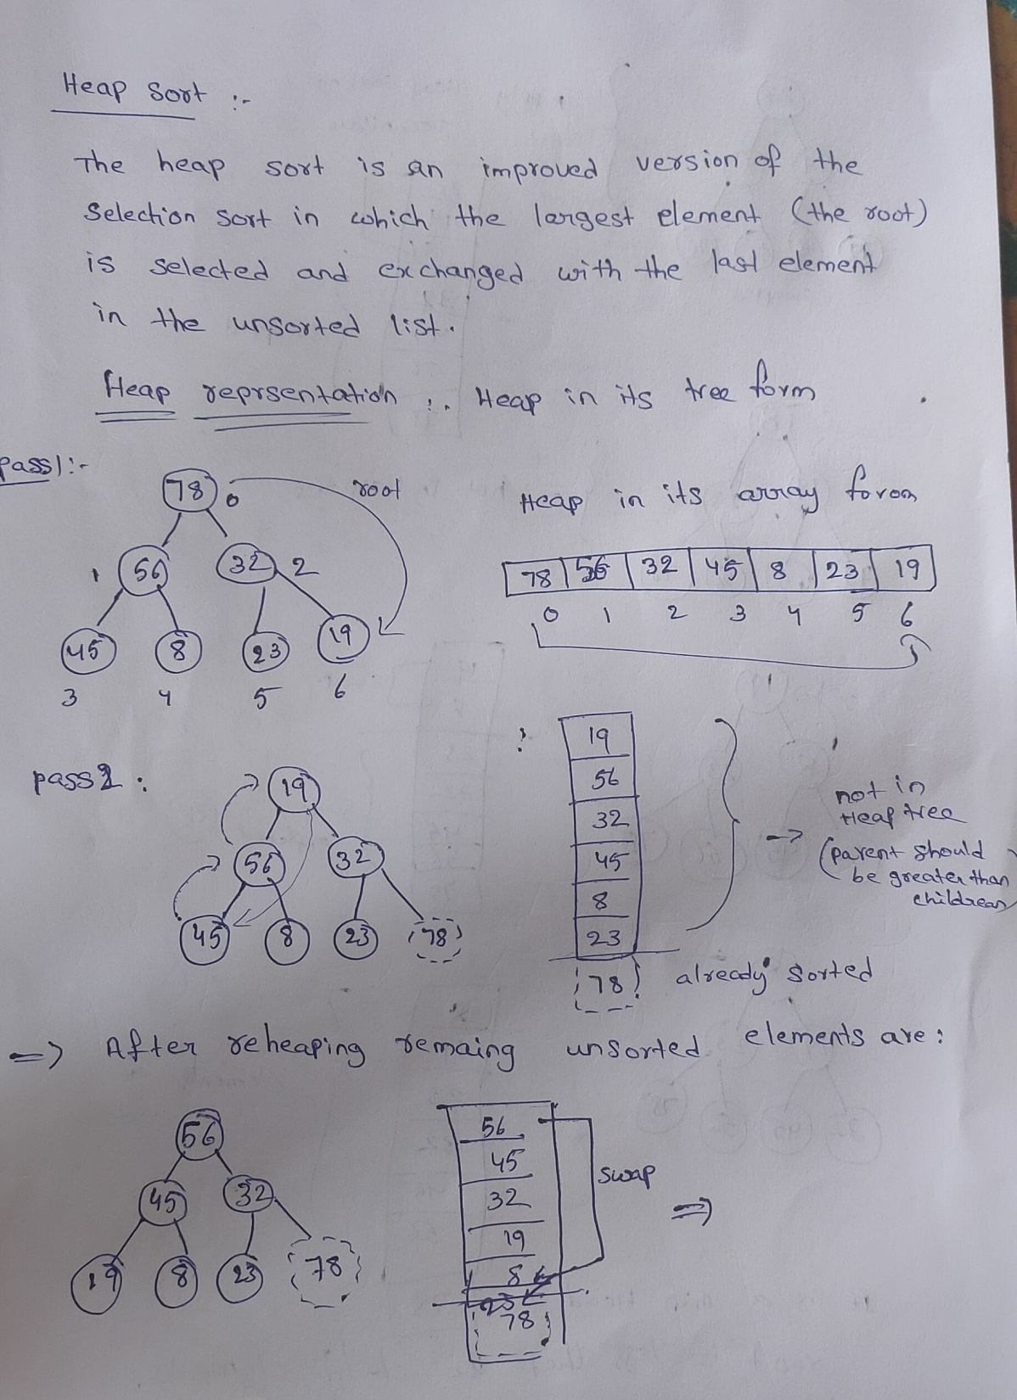

Slide 46
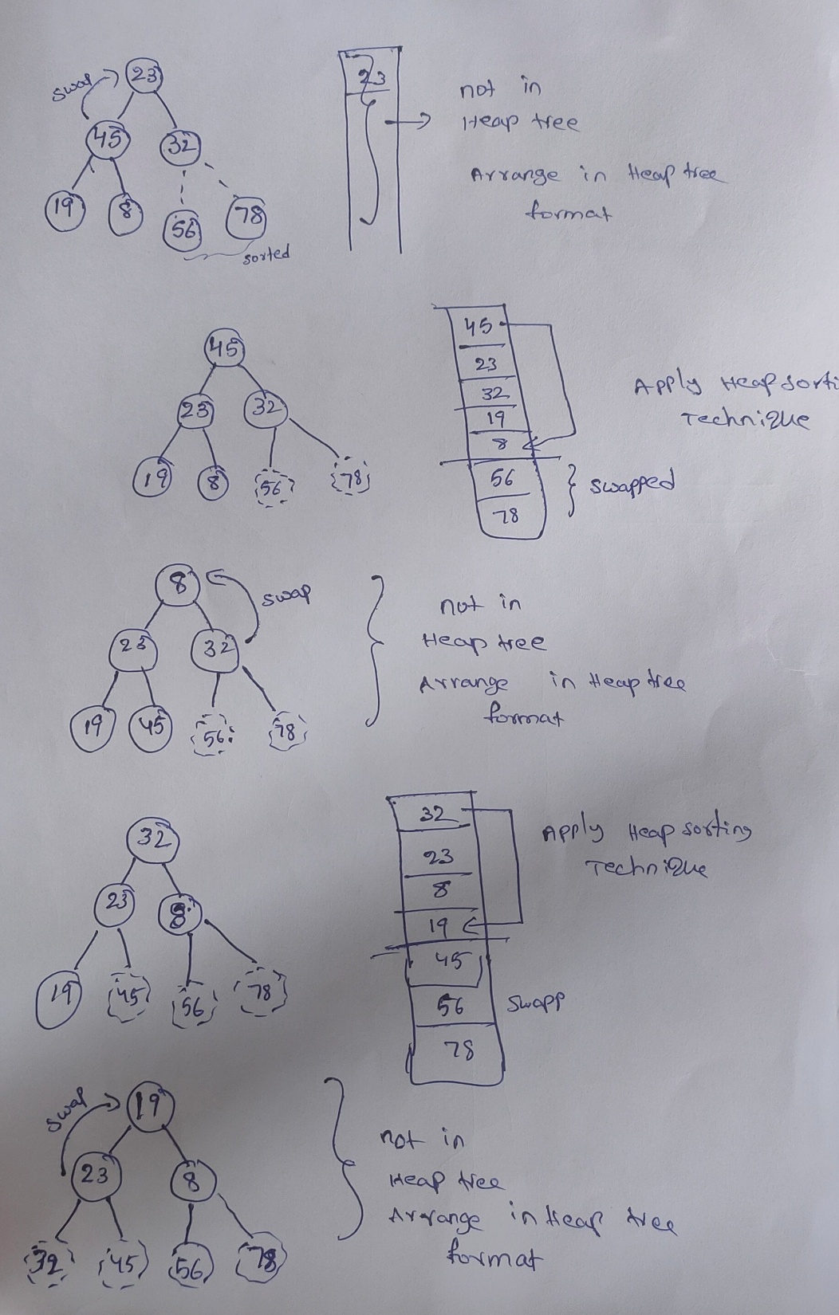

Slide 47
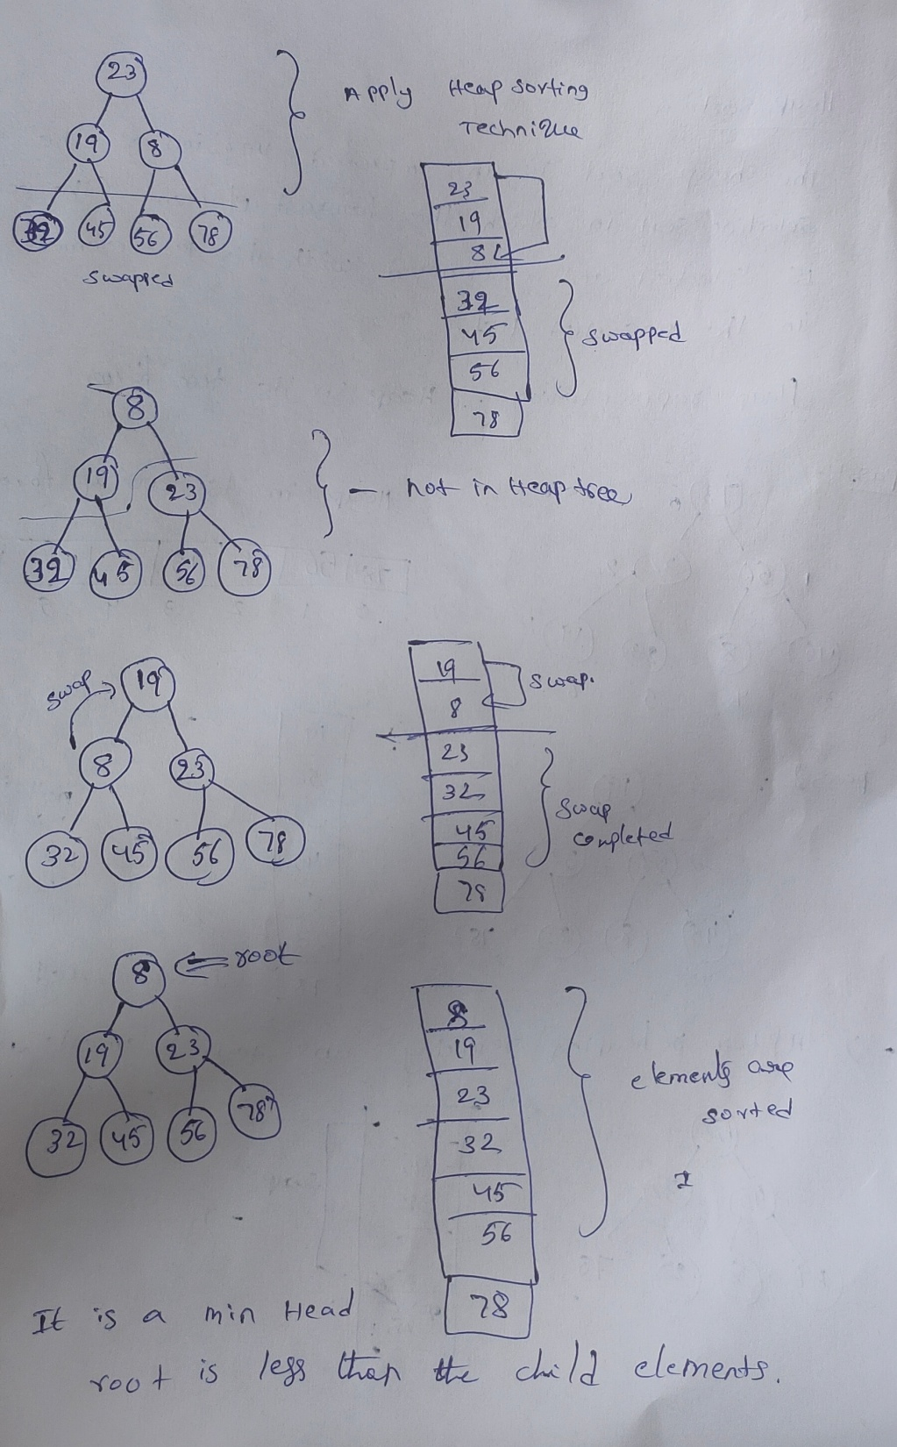

Slide 48
int main()
{
int arr[20],i,n;
printf("enter array size\n");
scanf("%d",&n);
printf("\nenter array values\n");
for(i=0;i<n;i++)
scanf("%d",&arr[i]);
heapSort(arr, n);
printf("sorted array is\n");
for(i=0;i<n;i++)
printf("%d\t",arr[i]);
return;
}
void heapSort(int arr[], int n)
{
int temp,i;
for (i = n / 2 - 1; i >= 0; i--)
heapify(arr, n, i);
for (int i = n - 1; i > 0; i-- )
{
temp = arr[0];
arr[0] = arr[i];
arr[i] = temp;
heapify(arr, i, 0);
}
}
void heapify(int arr[], int n, int i)
{
int largest = i; // Initialize largest as root
int l = 2 * i + 1; // left = 2*i + 1
int r = 2 * i + 2; // right = 2*i + 2
int swap;
if (l < n && arr[l] > arr[largest])
largest = l;
if (r < n && arr[r] > arr[largest])
largest = r;
if (largest != i)
{
swap = arr[i];
arr[i] = arr[largest];
arr[largest] = swap;
heapify(arr, n, largest);
}
}

Slide 49
Hashing
Hash Table
Hash functions

Slide 50
Why hashing?
Internet has grown to millions of users and terabytes of data every data.
It is impossible to find anything in the internet, unless we develop a new data structure to store and access the data very quickly.
The amount of time required to look up an element in an array or linked list is either O(logn) or O(n) based on the list is sorted or not.
New data structure called Hashing used to store and retrieve any entry with constant time O(1).
This technique is irrelevant to size of the list and order.
To increase the search efficiency the items to be stored in such a way as to make it easy to find them later.

Slide 51
Hash Table
hash table is a data structure to store and retrieve data very fast.
hash table consist of key and its value.
Each location in the hash table is called cell or bucket.
hash table is implemented using array.
An element is accessed very fast if we know the key or its index.
Example:
To store the Student record in hash table, Student rollno is used as a key
Hashing
Hashing is a technique used to generate key where an element is to be inserted or to be located from.

Slide 52
Hash Table: is a data structure that stores elements and allows insertions, lookups, and deletions to be performed in O(1) time
Hash table consist of key and its value. Each location in the hash table is called cell or bucket. hash table is implemented using array. An element is accessed very fast if we know the key or its index.
Example- to store the Student record in hash table, Student rollno is used as a key
There are two types of Hash Tables:
    Open-addressed Hash Tables
    Separate-Chained Hash Tables.
An Open-addressed Hash Table is a one-dimensional array indexed by integer values that are computed by an index function called a hash function.
A Separate-Chained Hash Table is a one-dimensional array of linked lists indexed by integer values that are computed by an index function called a hash function.
Hash tables are sometimes referred to as scatter tables
Hash Table Operations
  Search: compute f(k) and see if a pair exists
  Insert: compute f(k) and place it in that position
  Delete: compute f(k) and delete the pair in that position

Slide 53
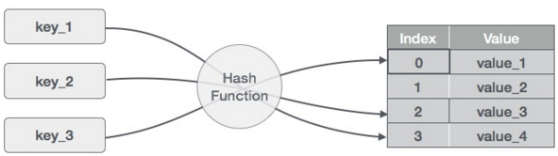
Hash Function
- to map the key value into its corresponding index in hash table hash function is used.
A hash function h transforms a key into an index in a hash table T[0…m-1]:
Where m is size of hash table.
Use hash function to compute the index in the hash table for the given
key value.
Hash function returns integer value which give the index value in the
hash table.

Slide 54
Hashing: Hashing is a process of mapping data items into positions in a hash table .
Hash function is a function which takes a piece of data (i.e. key) as input and outputs an integer (i.e. hash value) which maps the data to a particular index in the hash table.
In a hash table, a hash function is used to map keys into positions in a table. This act is called hashing
Ideal Hashing Example
Pairs are: 22,33,3,72,85- (key, value) pairs
Hash table is ht[0:7], m = 8 (where m is the number of positions in the hash table)
Hash function h is k % m = k % 8
Where are the pairs stored?
[0] [1] [2] [3] [4] [5] [6] [7]
3
72
72 33 85 22
[0] [1] [2] [3] [4] [5] [6] [7]
Ahash function, h, is a function which transforms a key from a set, K, into an index in a table of size n:
h: K -> {0, 1, ..., n-2, n-1}
A key can be a number, a string, a record etc.The size of the set of keys, |K|, to be relatively very large.It is possible for different keys to hash to the same array location.
This situation is called collision and the colliding keys are called synonyms.

Slide 55
Hashing
Hashing is a technique where we can compute the location of desired record in order to retrieve it in single access or comparison.
There are two types of hashing :
1. Static hashing: In static hashing, the hash function maps search-key values to a fixed set of locations.
2. Dynamic hashing: In dynamic hashing a hash table can grow to handle more items. The associated hash function must change as the table grows.
Advantages
To increase the efficiency i.e. to reduce the searching time, we need to avoid un necessary comparisons.
Operations of Hashing
1.Insertion of Records
2. Searching of Records
3. Deletion of Records
If L is the memory location where each record is related with the key.
If we can locate the memory address of a record from the key then the desired record can be retrieved in a single access.
For notational and coding convenience, we assume that the keys in k and the address in are (decimal) integers.
So the location is selected by applying a function which is called hash function or hashing function from the key k.

Slide 56
Hash Collision
Unfortunately such a function H may not yield different values (index or many address);it is possible that two different keys k1 and k2 will yield the same hash address. This situation is called Hash Collision
Hash Function
The basic idea of hash function is the transformation of the key into the corresponding location in the hash table. A Hash function H can be defined as a function that takes key as input and transforms it into a hash table index.
Hash functions are of two types:
1. Distribution- Independent function
2. Distribution- Dependent function
Distribution - Independent hash functions :
1. Division method
2. Mid Square method
3. Folding method.

Slide 57
Division method
TABLE is an array of database file where the employee details are stored.
Choose a number m, which is larger than the number of keys k. i.e., m is greater than the total number of records in the TABLE.
The number m is usually chosen to be prime number to minimize the collision.
The hash function H is defined by H(k) = k (mod m)
Where H(k) is the hash address (or index of the array) and here k (mod m) means the remainder when k is divided by m.
Example:
Let a company has 90 employees and 00, 01, 02, ...... 90 be the two digit 100 memory address (or index or hash address) to store the records. We have employee code as the key.
Choose m in such a way that it is grater than 90. Suppose m = 93. Then for the following employee code (or key k) : H(k) = H(2103) = 2103 (mod93) = 57
H(k) = H(6147) = 6147 (mod 93) = 9
H(k) = H(3750) = 3750 (mod93) = 30

Slide 58
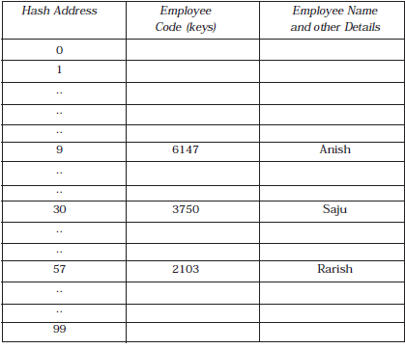

Slide 59
h(key)= record%M
where M is size of the hash table
Example:
store following records in hash table 34, 20, 68, 8, 26.
M is 10
use hash function to map them in hash table
A disadvantage of the division method is that consecutive keys map to consecutive hash values in the hash table. This leads to a poor performance.
0
1 | 34
2 | 68
3
4 | 26
5
6
7
8 | 8
9 | 20
34%11= 1
20%11=9
68%11=2
8%11=8
26%11=4

Slide 60
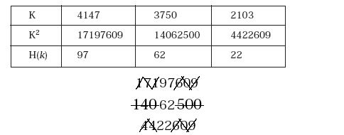
2.Mid Square Method
The key k is squared. Then the hash function H is defined by H(k) = k2 = r
Where r is obtained by digits from both the end of k2 starting from left. Same number of digits must be used for all of the keys.
It involves squaring the value of the key and then extracting the middle r digits as the hash value. The value of r can be decided according to the size of the hash table.
For example consider following keys in the table and its hash index :

Slide 61
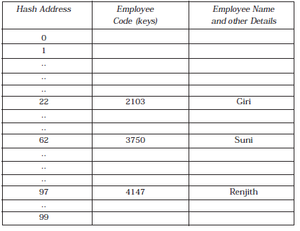
The disadvantage of this method is there will be collisions but we can try to reduce collisions as much as possible. Another limitation is the size of the key.

Slide 62
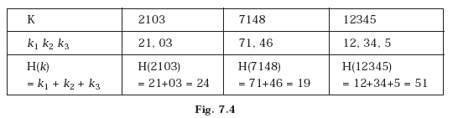
3.Folding Method
The key K, k1, k2,...... kr is partitioned into number of parts.
The parts have same number of digits as the required hash address, except possibly for the last part.
Then the parts are added together, ignoring the last carry.
H(k) = k1 + k2 + ...... + kr
Here we are dealing with a hash table with index form 00 to 99, i.e., two-digit hash table.
So we divide the K numbers of two digits.
H(7184) = 71 + 84 = 155, here we will eliminate the leading carry (i.e., 1).
So H(7184)= 71 + 84 = 55.

Slide 63
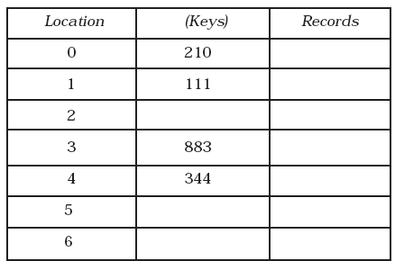
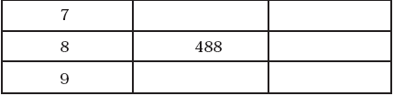
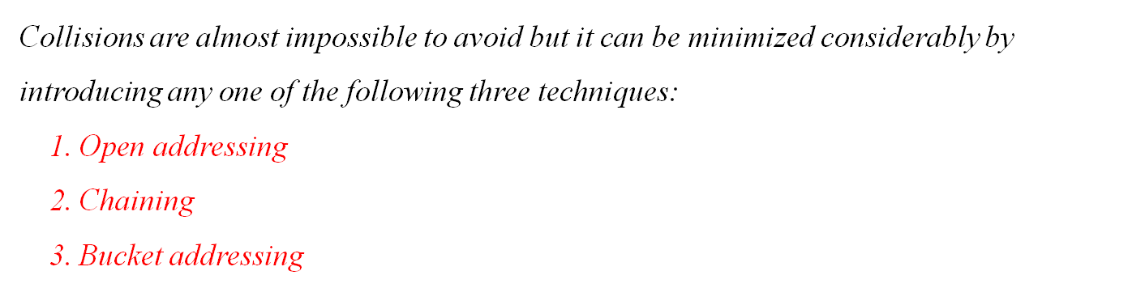
Hash Collision
Two or more keys are mapping to same location in the hash table is called collision.
Let us consider a hash table having 10 locations as shown in Fig.
Division method is used to hash the key.
H(k) = k (mod m)
If we want to insert a new record with key 500 then H(500) = 500(mod 10) = 0.
The location 0 in the table is already filled (i.e., not empty). Thus collision occurred.

Slide 64
Open Addressing
In open addressing method, when a key is colliding with another key, the collision is resolved by finding a nearest empty space by probing the cells.
LINEAR PROBING
Suppose a record R with key K has a hash address H(k) = h. then we will linearly search h + i (where i = 0, 1, 2, ...... m) locations for free space (i.e., h, h + 1, h + 2, h + 3 ......hash address)
The main disadvantage of Linear Probing is that substantial amount of time will take to find the free cell by sequential or linear searching the table.
QUADRATIC PROBING
Suppose a record with R with key k has the hash address H(k) = h. Then instead of searching the location with address h, h + 1, h + 2,...... h + i ......, we search for free hash address h, h + 1, h + 4, h + 9, h + 16, ...... h + i2,...... .
DOUBLE HASHING
Second hash function H1 is used to resolve the collision.
Suppose a record R with key k has the hash address
H(k) = h and H1(k) = h1, which is not equal to m.
Then we linearly search for the location with addresses
h, h + h1, h + 2h1, h + 3h1, ...... h + i (h1)2 (where i = 0, 1, 2, ......).

Slide 65
Linear probing (linear search)
Idea is that when the collision occurs, find the next available slot in the hash table (i.e probing)
The process wraps around to the beginning of the table
Example 89, 18, 49, 58, 9 and hash table size is 10
H(k) or Hash value=key mod m
H_{i}(key)= (Hashvalue+i) mod m
Where,
m may be table size or any prime number
0 | 1 | 2 | 3 | 4 | 5 | 6 | 7 | 8 | 9
49
58
9
18
89
89%10=9
18%10=8
49%10=9
58%10=8
9%10=9

Slide 66
2. Quadratic probing
It operates by taking hash value and adding successive values of an arbitrary quadratic polynomial.
Uses following formula
H(k) or Hash value=key mod m
H_{i}(key)= (Hashvalue+i²)%m
Where,
m may be table size or any prime number

Slide 67
Ex- 37,99,55,22,11, 17,40,87
37%10=7
11%10=1
99%10=9
17%10=7 but already occupied
55%10=5
Consider i=0 then
(7+0²)%10=7
(7+1²)%10=8
22%10=2
0 | 1 | 2 | 3 | 4 | 5 | 6 | 7 | 8 | 9
40
11
22
55
87
37
17
99
40%10=0
87%10=7 occupied
(7+1²)%10=8 occupied
(7+2²)%10=1 occupied
(7+3²)%10=6

Slide 68
4. Double hashing
Second hash function is applied when a collision is occurred.
the resultant of second hash function is to get the number of positions from the point of collision to insert.
H₁(key)= keyvalue%tablesize
H₂(key)= M-(key % M)
Where,
M is prime number smaller than table size.

Slide 69
Ex- 37,90,45,22,17,49,55
H₁(37)=37%10=7
H₁(17)=17%10=7
H₂(17)=7-(17%7)=4
Move 4 locations from collision
H₁(90)=90%10=0
H₁(49)=49%10=9
H₁(45)=45%10=5
H₁(55)=55%10=5
H₂(55)=7-(55%7)=1
Move one location from collision
H₁(22)=22%10=2
0 | 1 | 2 | 3 | 4 | 5 | 6 | 7 | 8 | 9
90
17
22
45
55
37
49

Slide 70
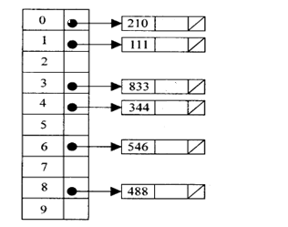
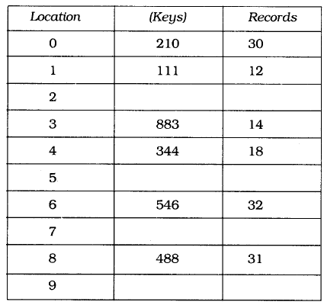
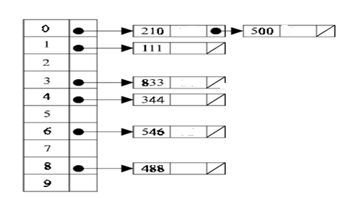
2. Chaining
In chaining technique the entries in the hash table are dynamically allocated and entered into a linked list associated with each hash key.

Slide 71
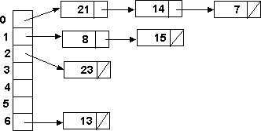
Hash table is implemented as array of linked list.
All the records which are mapped to same hash address are linked together to form a linked list.
Example: Load the keys 23, 13, 21, 14, 7, 8, and 15 , in this order, in a hash table of size 7 using separate chaining with the hash function: h(key) = key % 7
h(23) = 23 % 7 = 2
h(13) = 13 % 7 = 6
h(21) = 21 % 7 = 0
h(14) = 14 % 7 = 0 collision
h(7) = 7 % 7 = 0 collision
h(8) = 8 % 7 = 1
h(15) = 15 % 7 = 1 collision

Slide 72
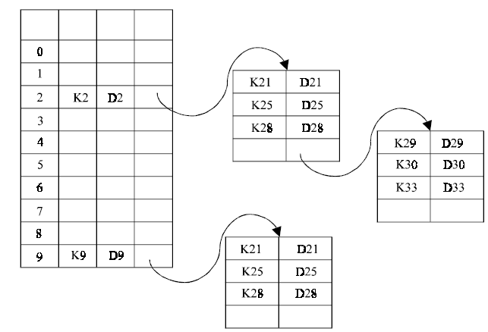
3. Bucket Addressing
Another solution to the hash collision problem is to store colliding elements in the same position in table by introducing a bucket with each hash address.
A bucket is a block of memory space, which is large enough to store multiple items.
If a bucket is full, then the colliding item can be stored in the new bucket by incorporating its link to previous bucket.

Slide 73
Hashing a string key
Table size [0..99]
A..Z ---> 1,2, ...26
0..9 ----> 27,...36
Key: CS1 --->3+19+28 (concat) = 31,928
(31,928)² = 1,019,397,184 - 10 digits
Extract middle 2 digits (5th and 6th) as table size is 0..99.
Get 39, so: H(CS1) = 39.
Characteristics of a Good Hash Function
The hash value is fully determined by the data being hashed.
The hash function uses all the input data.
The hash function "uniformly" distributes the data across the entire set of possible hash values.
The hash function generates very different hash values for similar strings.

Slide 74
Some Applications of Hash Tables
Database systems: Specifically, those that require efficient random access. Generally, database systems try to optimize between two types of access methods: sequential and random. Hash tables are an important part of efficient random access because they provide a way to locate data in a constant amount of time.
Symbol tables: The tables used by compilers to maintain information about symbols from a program. Compilers access information about symbols frequently. Therefore, it is important that symbol tables be implemented very efficiently.
Data dictionaries: Data structures that support adding, deleting, and searching for data. Although the operations of a hash table and a data dictionary are similar, other data structures may be used to implement data dictionaries. Using a hash table is particularly efficient.
Network processing algorithms: Hash tables are fundamental components of several network processing algorithms and applications, including route lookup, packet classification, and network monitoring.
Browser Cashes: Hash tables are used to implement browser cashes.

Slide 75
Problems for Which Hash Tables are not Suitable
Problems for which data ordering is required: Because a hash table is an unordered data structure, certain operations are difficult and expensive. Range queries, proximity queries, selection, and sorted traversals are possible only if the keys are copied into a sorted data structure. There are hash table implementations that keep the keys in order, but they are far from efficient.
2. Problems having multidimensional data.
3. Prefix searching especially if the keys are long and of variable-lengths.
4. Problems that have dynamic data: Open-addressed hash tables are based on 1D-arrays, which are difficult to resize once they have been allocated. Unless you want to implement the table as a dynamic array and rehash all of the keys whenever the size changes. This is an incredibly expensive operation. An alternative is use a separate-chained hash tables or dynamic hashing.
5. Problems in which the data does not have unique keys: Open-addressed hash tables cannot be used if the data does not have unique keys. An alternative is use separate-chained hash tables.

